Slide 1
Problem Statement
Trying to build a model based on some historical data, whether the person prefer going to a Physiotherapy or not. From the business point view, its an attempt to increase the Physiotherapy awareness in India to avoid medicines as much as possible.

Slide 2
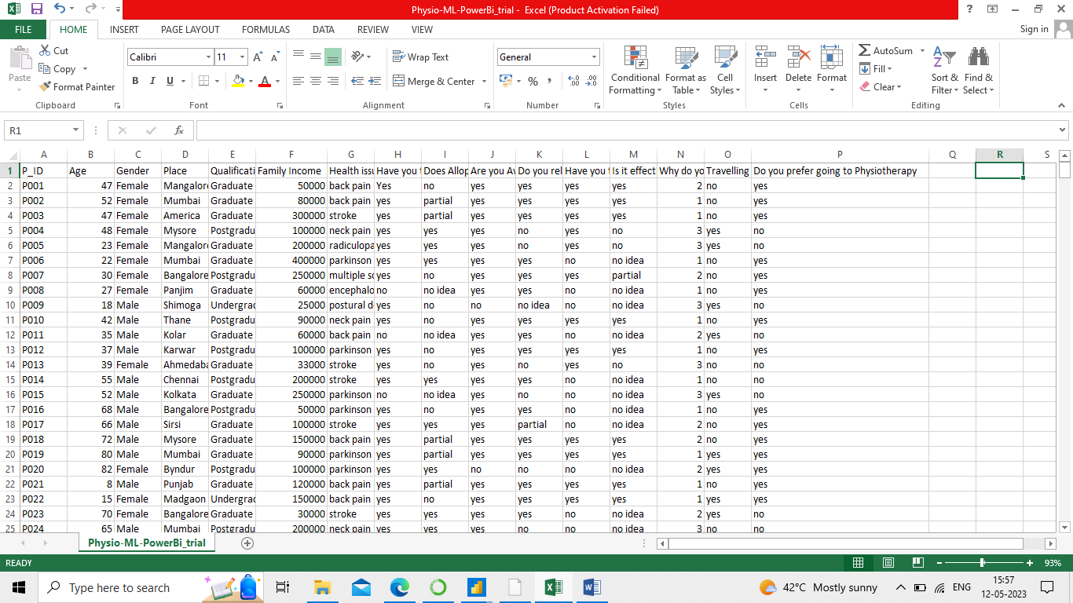
About Dataset
This comes under supervised Learning and a Classification problem.
There are 15 features and 1 target column.
Screen shot of the dataset is as below.

Slide 3
Features of the Dataset
1. P_ID
2. Age
3. Gender
4. Place
5. Qualification
6. Family_Income
7. Health_Issues
8. Have you taken the Allopathic treatment before?
9. Does Allopathic worked for you
10. Are you Aware about Physiotherapy
11. Do you rely on this?
12. Have you taken any Physiotherapy treatment before?
13. Is it effective?
14. Why do you want to go to Physiotherapy?(To avoid medicine, To avoid surgery, Just for relaxation)
15. Travelling issue (Difficulty in visiting doctor on daily basis for completing the session)
16. Do you prefer going to Physiotherapy?

Slide 4
About Data Cleaning, EDA and Feature Engineering on Dataset
There were some null records, which has been removed.
There were some duplicate values as well, which got cleared by using PowerBI.
Unwanted column like Patient ID(P_ID) has been removed.
Since majority of the features are of object type, so converted all those features to numeric data type by using Label Encoding technique.
Data has been visualized to get the insight of the data.
A Dashboard is created in PowerBI, to analyze and to get the insight of the dataset in depth.
Data is also standardized by using StandardScaler() library.

Slide 5
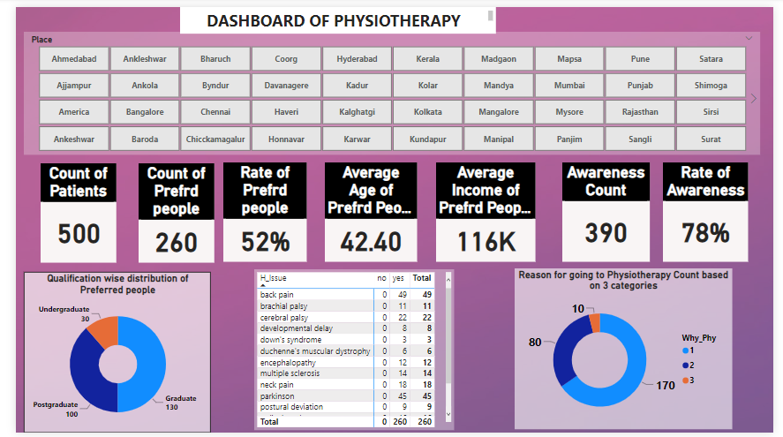
Dashboard in PowerBI

Slide 6
General Model Building Steps
Import the right kind of data set according to the problem .
Data Cleaning is performed.
Explore and visualize the data to gain the insights of the data by using visualization technique.
Relationship between the “Features” and “Target” should be figured out.
All the necessary categorical variables are encoded by using LabelEncoder()
Identify the Target variable and then we have to divide the data into X(Features) and y(Target)
Next step is to split the data into Train set and Test set with a ratio of 80:20, 60:40 or 70:30 etc.
Then build the model with the Training data set.
Test the model on Test data set
Then find accuracy of both Train model and Test model to check whether the model is over fitting or Under fitting.
Next is to Evaluate the model.

Slide 7
Types of Algorithms to solve Classification Problems
There are different Algorithms under Classification Problem
Logistic Regression
Decision Tree
RandomForest
KNN
SVM
Naïve Bayes

Slide 8
Theory of Logistic Regression
Why Logistic Regression
Maths behind Logistic Regression
Sigmoid Curve
Odds Ratio
Probability
Log Odds
Evaluation techniques of Classification problem
Confusion Matrix
Classification Report
ROC & AUC curve

Slide 9
Why Logistic Regression????
Logistic Regression is mostly used for Binary Classification problems.
The theory of logistic regression is an extended part of Linear Regression, that is why the name Regression has been continued even though it is used to solve the classification problems.
Formula of Linear Regression is Y=mx+c
Formula for Logistic Regression is 1/1 + e^{-z} where Z = mx + c
By Linear Regression, it yields the value between –infinity to +infinity
By Logistic Regression, we get a value ranging between 0 to 1, which helps in Binary classification

Slide 10
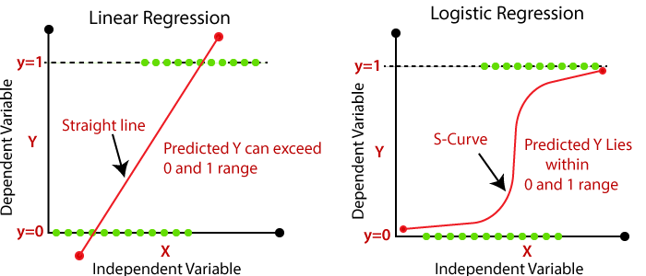
Maths behind Logistic Regression
a. Sigmoid Curve

Slide 11
Maths behind Logistic Regression
b. Odds Ratio : Success / Failure
c. Probability : Success / Total Attempts
d. Log Odds : Transforming a data from skewed to a normally distributed data.

Slide 12
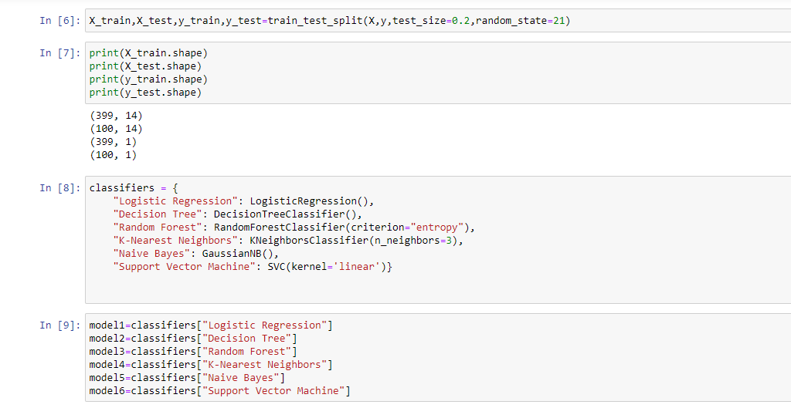
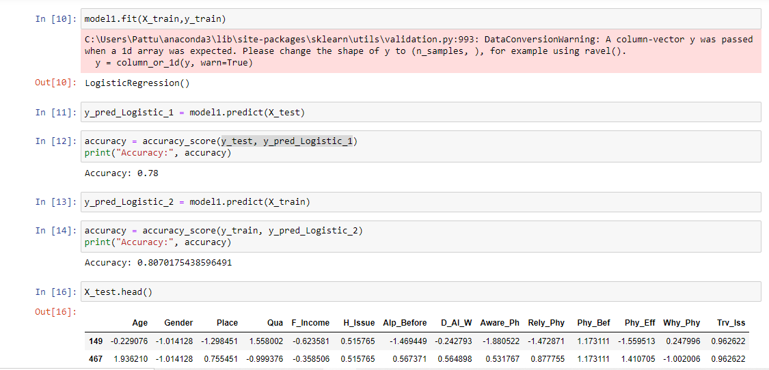
Code Screenshot

Slide 13
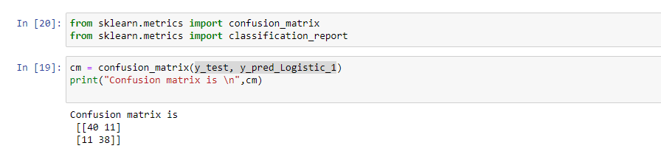
Evaluation Techniques of Classification
a. Confusion Matrix : The main goal of the confusion matrix is to understand the mis classification.
P R E D I | Actual Values
 | TP | FP
 | FN | TN

Slide 14
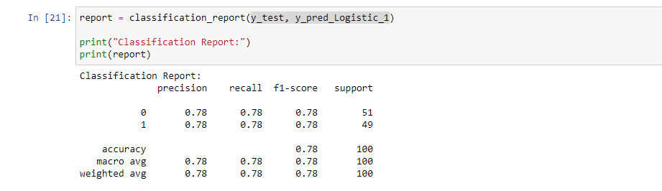
b. Classification Report : This includes Accuracy, Precision, Recall and Support.
Accuracy : TP + TN / TP+TN+FP+FN
Precision(Stability) : 1. Positive – TP/TP+FP
2. Negative – TN/TN + FN
Recall( Individual Class accuracy) : 1. Positive – TP/TP+FN
2. Negative – TN/TN+FP
F1 Score : It’s a Harmonic mean of precision and Recall
(2 * Recall * precision) / Recall + Precision
Support : 1. Positive – TP+FP
2. Negative – TN + FN

Slide 15
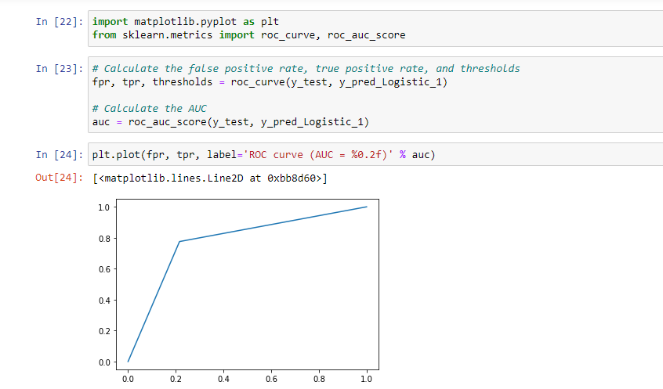
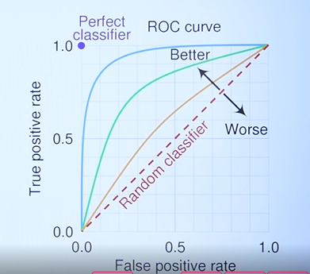
ROC & AUC curve : We need to have very less FP and FN rate and should have high TP and TN
Model Drift : change/drop in accuracy is called as “Model Drift”, in that case we need to retrain the model for the better accuracy. Model drift can identified by regular observation.

Slide 16
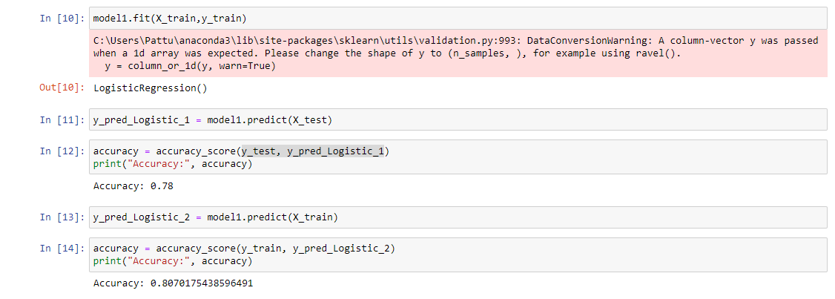
Conclusion (This is with train_test_split)
We got an accuracy of 78% with the Test data and an accuracy of 80% on Train data.
We can attempt to get a better accuracy by using some Hyper parameters or by changing the model. Tried with some of the Hyper parameters like ‘l1’ and ‘l2’ but there is no change in Accuracy.

Slide 17
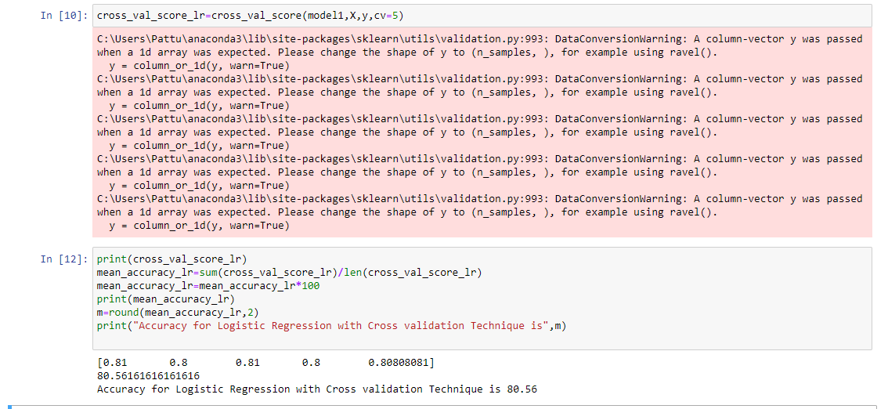
Conclusion (This is with Cross validation Technique)

Slide 18
Decision Tree Algorithm
Why Decision tree??
Maths behind Decision tree
Evaluation techniques of Classification problem
Confusion Matrix
Classification Report
ROC & AUC curve

Slide 19
Why Decision Tree???
It’s a Non-Parametric model.
It forms a tree like structure based on conditions.
We need to understand here 3 terms
Root Node
Decision Node
Leaf

Slide 20
Maths behind Decision Tree???
There are different techniques while forming a Tree structure.
CART (Classification and Regression Tree) – This follows Gini Index
ID3 (Iterator Ditomizer 3 )
Entropy
Information Gain
CHAID
ID 4.5

Slide 21
Formulae
CART – Gini Index = 1 - ∑ ( P A)²
1 – [ P (A)² + P (B)² ]
If Gini Index is zero then it is a Leaf or else it’s a Decision Node
ID3
Entropy –
This is used to decide the Decision Node
Impurity in the node – E= -P_{A} log P_{A} - P_{B} log P_{B}
If the Entropy is zero then then that node is a Leaf or else if it is greater that zero then it will be a Decision Node.
Information Gain
This decides the Root Node
Information Gain= Total Entropy – Average Entropy
Total Entropy = -P_{A} log P_{A} - P_{B} log P_{B}
Average Entropy = n(Graduates)/n * E(graduates) + n(Undergraduates)/n * E(Undergraduates) + n(Postgraduates)/n * E(Postgraduates)
This way Information gain of each column is calculated and then the column with the highest Information Gain is considered as the “Root Node”.

Slide 22
Pro’s and Con’s of Decision Tree
Pro’s
It is having a good Hyper parameter training
Having In-built feature selection (with the technique of Information Gain)
It can handle Outliers easily
Con’s
Major draw back is Over fitting
It can be over come by the technique called as “Pruning”
The draw backs of Decision tree can be overcome by Ensemble technique called as “Bagging” and “Boosting”.
Bagging is Parallel
Boosting is sequential
When we apply bagging technique on Decision Tree, its called as “Random Forest”
When we apply boosting technique on Decision Tree, its called as “Gradient Boosting”

Slide 23
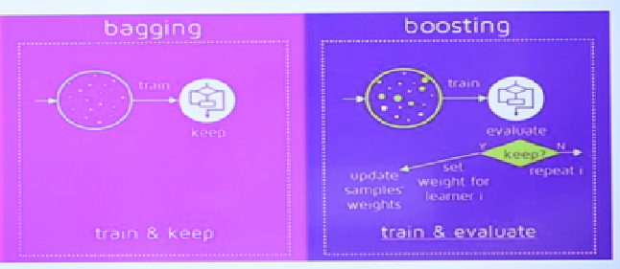
Bagging and Boosting
Decision tree forms a one single tree like structure but where as in Bagging technique or we can say in RandomForest, It uses multiple small Decision trees and at the end it takes the majority voting and then decides the accuracy. Bagging is a parallel process, since here multiple trees are formed parallel.
There will not be any over fitting problem and is more stable model.
Boosting is a parallel process, which means that, it forms a sub tree, finds the accuracy and if it is less it rebuilds the model based on the mistakes of the first one, and again next tree it takes and the same process will be continued until it reaches the best accuracy.
it will keep doing the process serially, that is one after the other, so it is called as “Sequential”. In short, here we train it, evaluate it and again retrain it until we reach the very good accuracy. Where as in Bagging we train it once and keep it. XGBoost can be used for best accuracy.

Slide 24
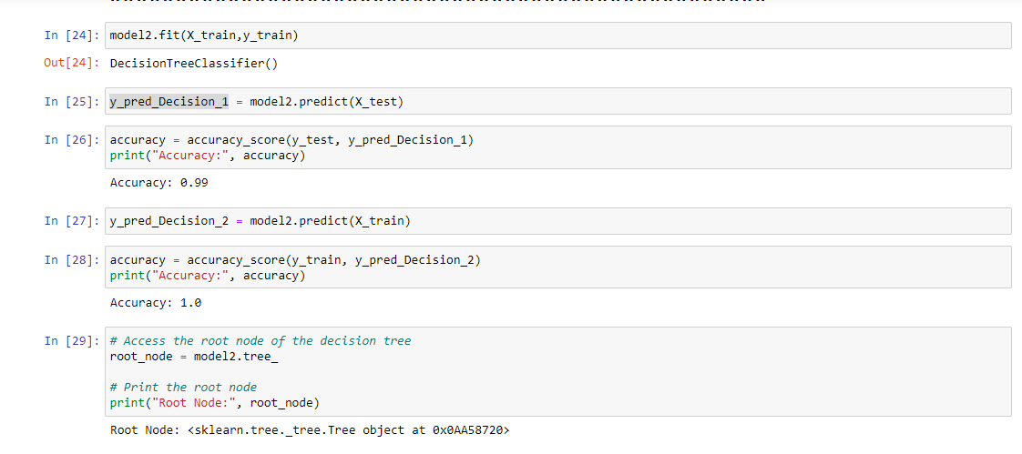
Code Screenshot

Slide 25
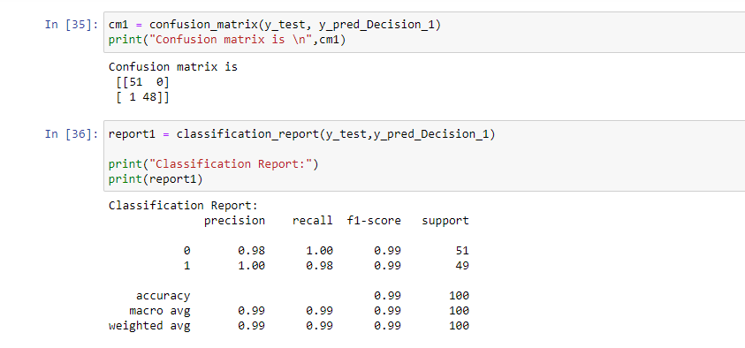
Code Screenshot

Slide 26
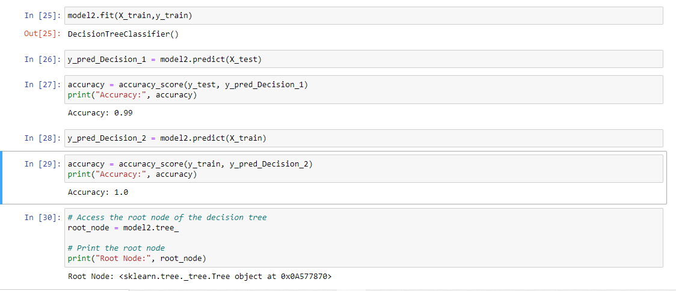
Conclusion (This is with train_test_split)
We successfully got an accuracy of 99%, with only 1 miss classification.
Even this can be overcome by Bagging technique which is nothing but “RandomForest” Classifier.

Slide 27
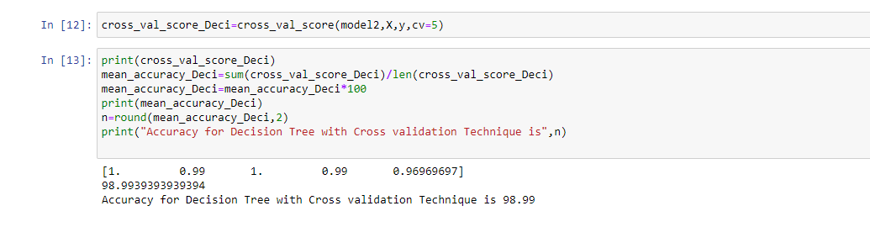
Conclusion (This is with Cross validation Technique)

Slide 28
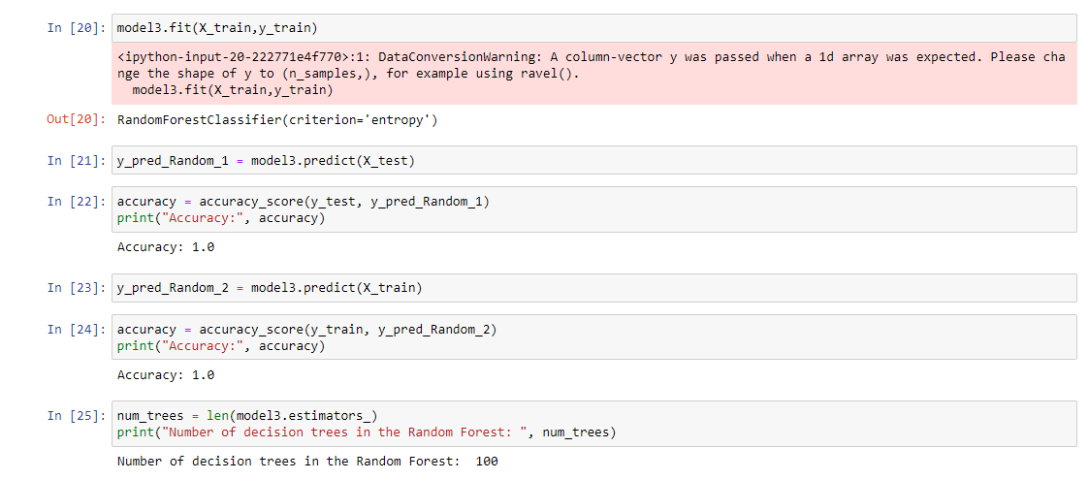
RandomForest Classifier
We reached an accuracy of 100% as per the Bagging technique concepts which is there in RandomForest.

Slide 29
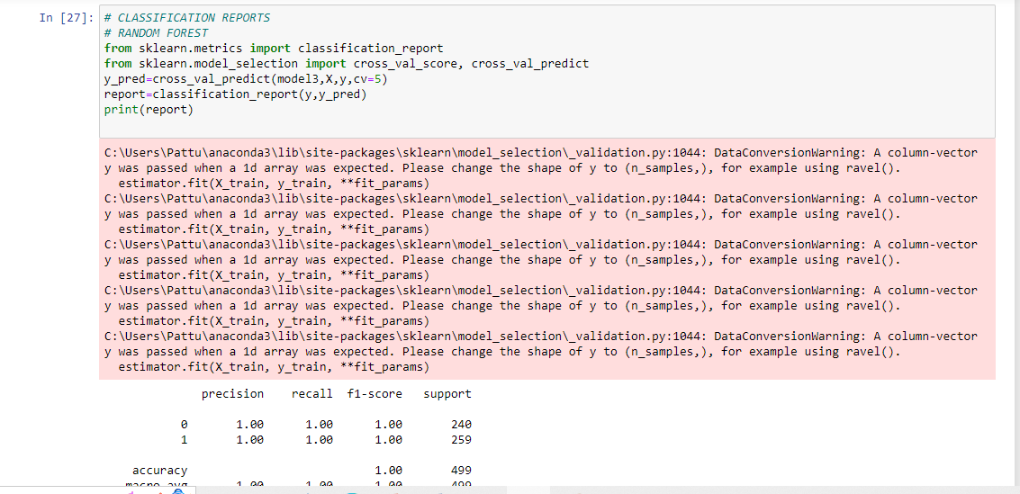
Conclusion (This is with Cross validation Technique)

Slide 30
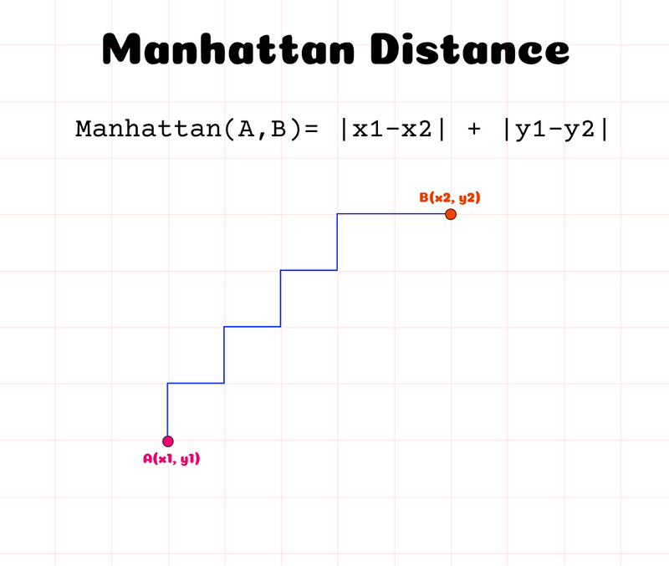
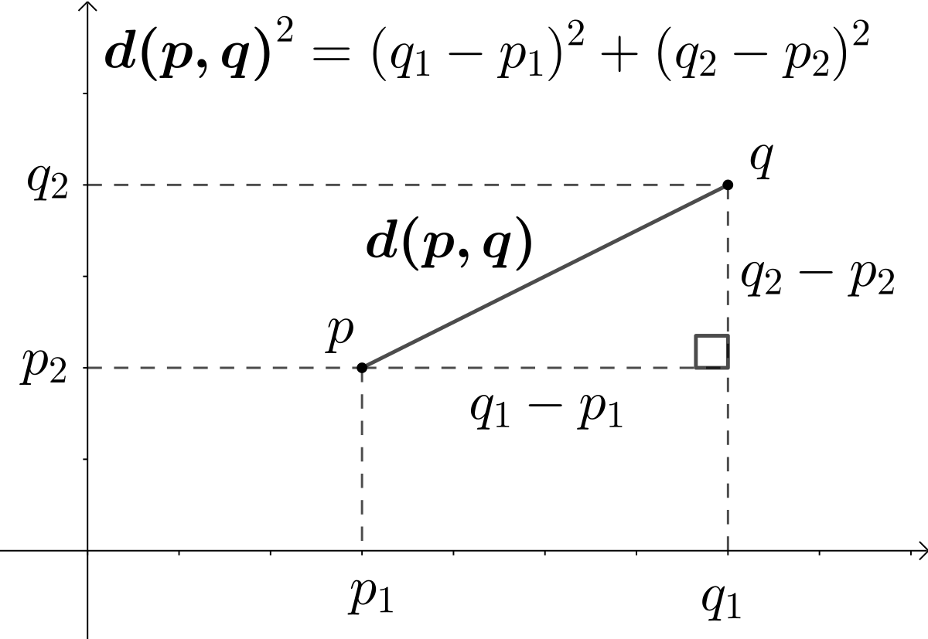
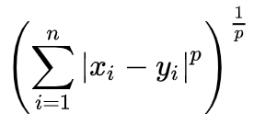
KNN Algorithm
It’s a Lazy Algorithm
It’s an Instance based Learning Algorithm
Lazy learning
Non-Parametric
Eucleadian Distance
Minkowski Distance

Slide 31
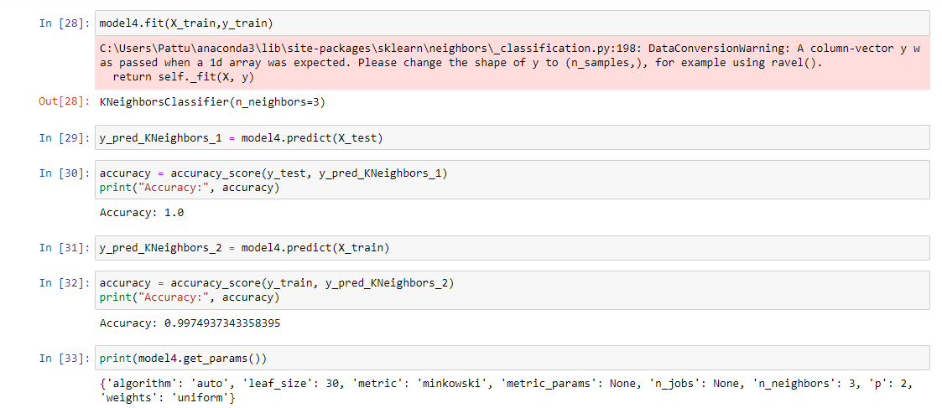
KNN Classifier

Slide 32
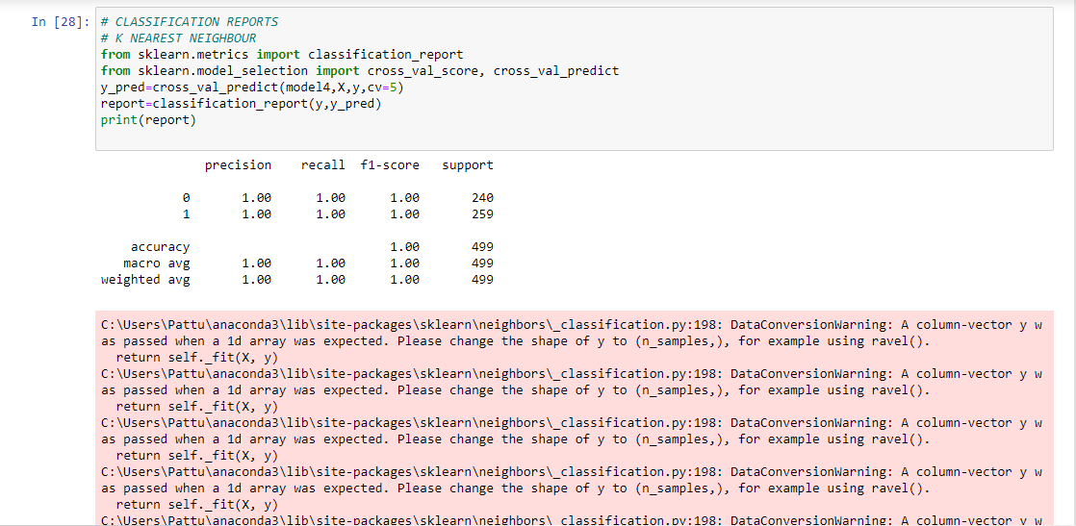
Conclusion (This is with Cross validation Technique)

Slide 33

Support Vector Machine
It is one of the Advanced Algorithm.
SVM is a robust Algorithm, with highest time needed for building the model.
It is based on the concept of Hyperplane.
This algorithm builds multiple hyperplanes, among which a best suitable hyperplane is selected based on the nearest points called as “support vectors”.
The plane which separates the data points is called as “Plane of Separator”.
There may be a situation where a Hyperplane may not be able to separate the points in which the data points are distributed in a circular form, in that case a trick called “Kernel” is used to separate the data.
There are around 7 Kernels, but 3 popular once are Linear, Polynomial and Radial.
Kernel trick converts Non-separable data to separable data by changing the feature combination.
It creates 2 different margins beside the Hyperplane which satisfies the equation wx+b=+1, wx+b=-1 and the hyperplane with wx+b=0
Wx+b is calculated by using Gradient Descent technique.

Slide 34
SVM can be of two types:
Linear SVM: Linear SVM is used for linearly separable data, which means if a dataset can be classified into two classes by using a single straight line, then such data is termed as linearly separable data, and classifier is used called as Linear SVM classifier.
Non-linear SVM: Non-Linear SVM is used for non-linearly separated data, which means if a dataset cannot be classified by using a straight line, then such data is termed as non-linear data and classifier used is called as Non-linear SVM classifier.

Slide 35
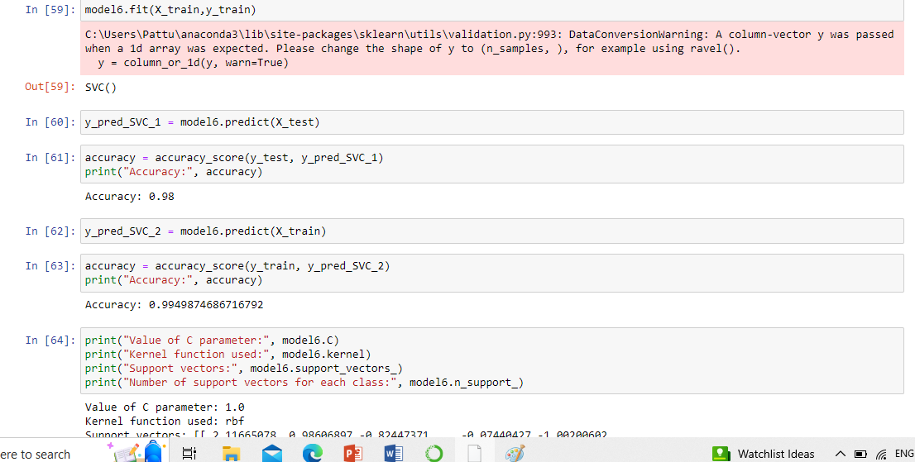
Conclusion (This is with Train-Test Technique)

Slide 36
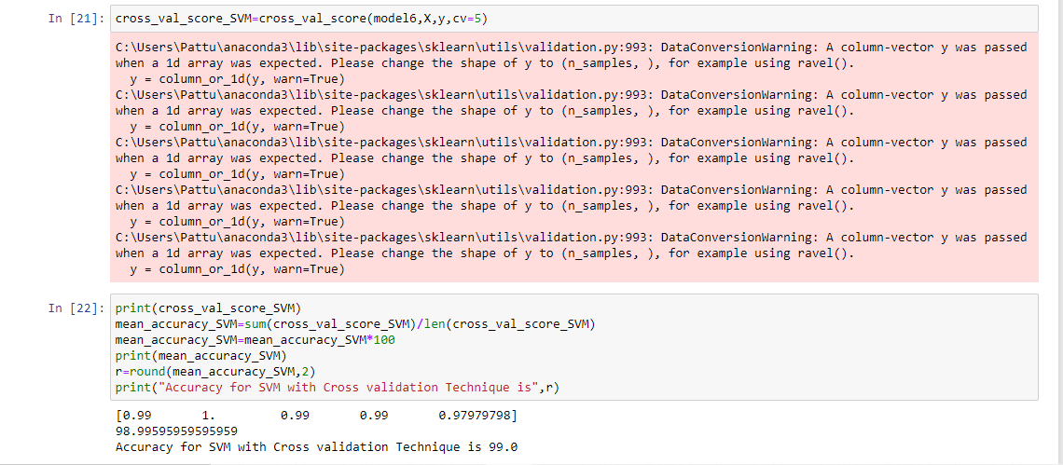
Conclusion (This is with Cross validation Technique)

Slide 37
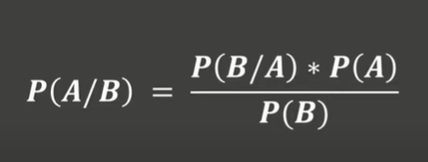
Naïve Bayes Theorem
It is based on the concept of conditional probability.
Thomas Bayes discovered this theory
Algorithm first calculates the Probability of both the classes of the target column i.e P(A) and P(B) respectively
In this problem it is P(YES) and P(NO)
Then the expansion of each and every column is done to calculate the P(A/B) with respect to each and every column.
Then finally we get the Probability of each and every column

Slide 38
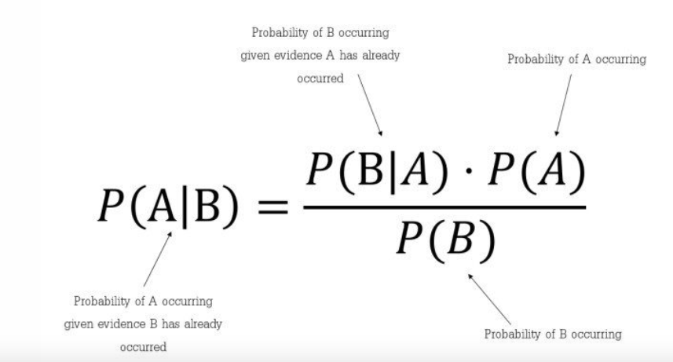

Slide 39
For eg. With respect to the dataset used here i.e. “Physiotherapy” will write the formula, will take here around 3 columns and try to write the formula.
Test Data will take it as : Rely_Phy : Yes, Phy_Before: No, Aware_Phy:Yes
P(Yes| X) = P(Yes)* P(Rely_on_phy|Yes) * P(Phy_Before|Yes)* P(Aware_Phy|Yes)
Here respective value will be substituted and will get some value for P(Yes|X)
P(No|X) = P(No) * P(Rely_on_phy|No) * P(Phy_Before|No)* P(Aware_Phy|No)
Here also will get some value for P(No|X) after substituting the respective values
Then both P(Yes|X) and P(No|X) is compared, whichever is the highest value, that particular class is the given test data belongs to.
Suppose let us imagine P(No|X) > P(Yes|X) then the prediction by our model will be “No” i.e. Patient will not prefer Physiotherapy.

Slide 40
The Zero-Frequency Problem
One of the disadvantages of Naïve-Bayes is that if you have no occurrences of a class label and a certain attribute value together then the frequency-based probability estimate will be zero. And this will get a zero when all the probabilities are multiplied.
An approach to overcome this ‘zero-frequency problem’ in a Bayesian environment is to add one to the count for every attribute value-class combination when an attribute value doesn’t occur with every class value.

Slide 41
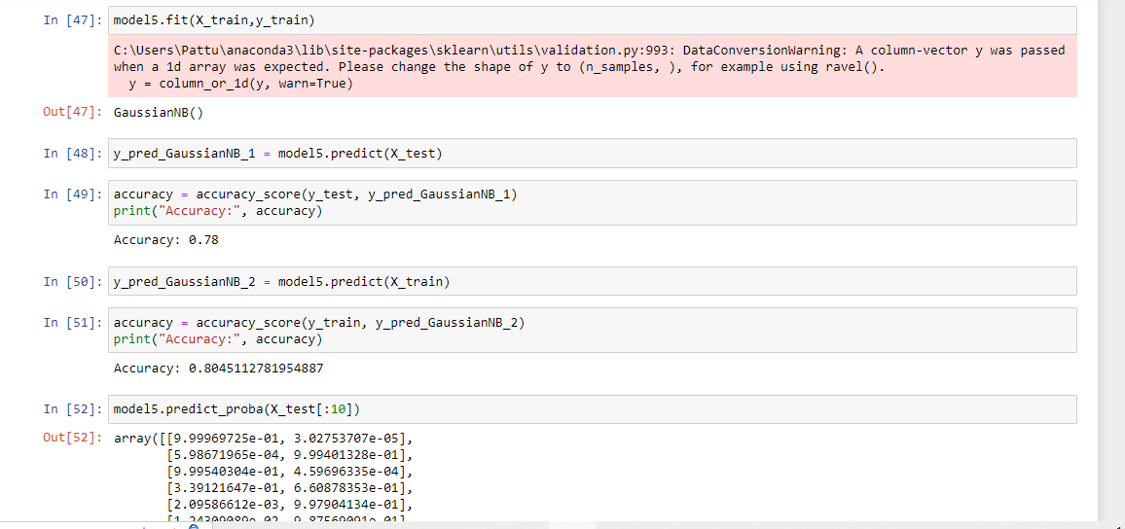
Conclusion (This is with Train-Test technique)

Slide 42
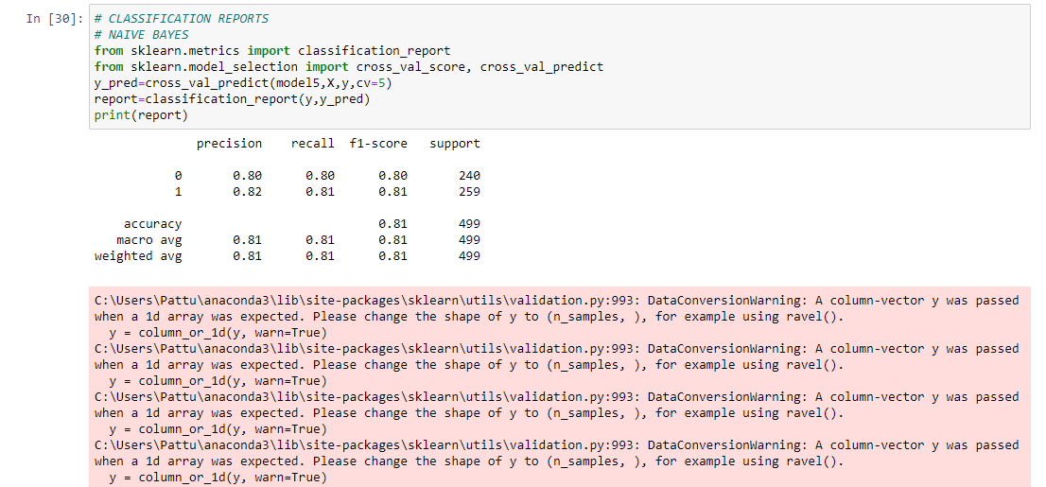
Conclusion (This is with Cross validation Technique)

Slide 43
Comparison of Accuracy of different Algorithms
Algorithm | Accuracy with Train-test | Accuracy with Corss_val
Logistic Regression | 78% | 80%
Decision Tree | 99% | 98%
Random Forest | 100% | 100%
KNN | 100% | 100%
SVM | 98% | 99%
Naïve Bayes | 78% | 80%
So we can conclude that, the model fits best with “RandomForest” and “KNN” Algorithms with an Accuracy of 100%

